Slide 1
Stay in NBA pridiction
Member : 107753026 簡豪廷
107753031 江承憲
107753040 陳遠

Slide 2
Goal
NBA personnel changes are very important for a loyal NBA audience. In particular, the audience has a lot of attention to the team that they like, and even the movement of a certain player.
So we designed a variety of information through historical players to train, trying to predict whether a player will continue to play in the NBA in the next season.

Slide 3
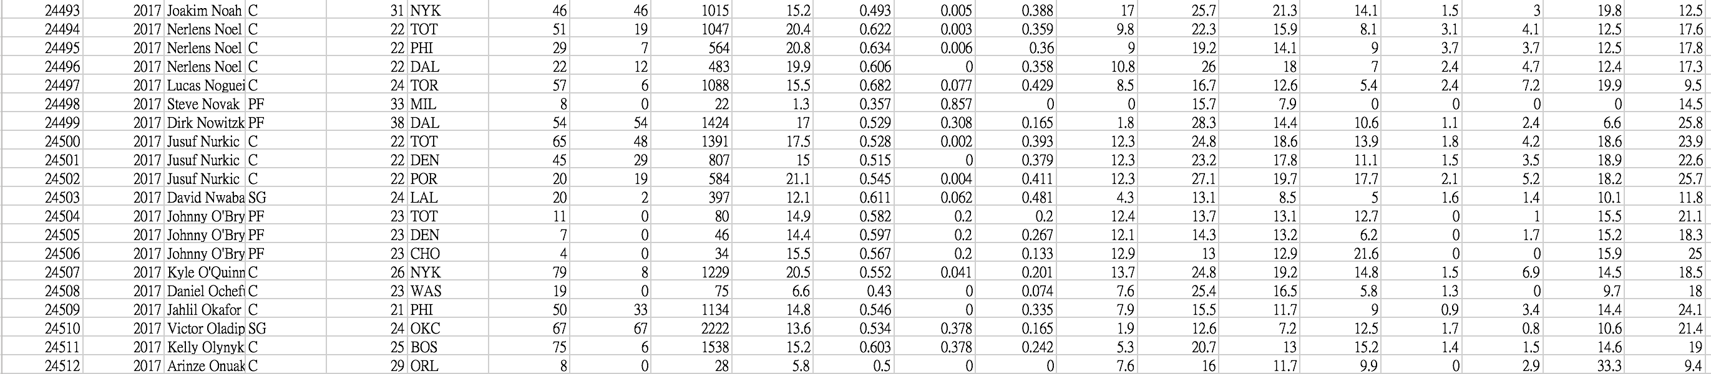
Input
Data source : NBA_Seanaons_Stats
Input format : .csv
Preprocessing
Scale value
Add a Attribute about player stay in next season or not (0/1)

Slide 4
Modeling
Method : Random forest（ ntree=100）
perform evaluation : n-fold

Slide 5
Factor
Age (年紀)
G (上場數)
Gs (先發)
Mp (出場時間)
Pev (效率值)
Ts% (真實命中率)
3PAr (中三分率)
FTr (罰球獲得率)
TRB (總籃板數)
AST (平均助攻)
STC (抄截)
BLK (助攻)
Tov (失誤)
USG (球員使用率)
WS (勝利貢獻率)

Slide 6
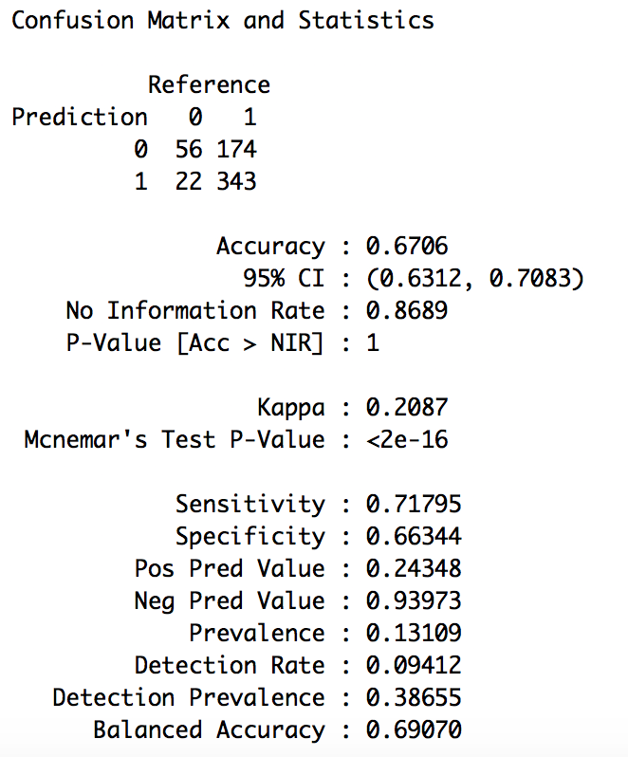
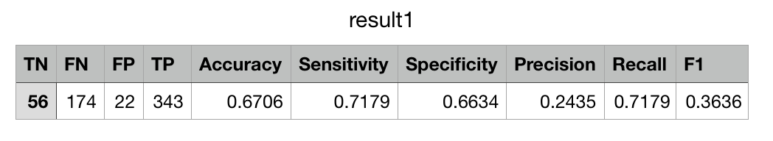
Output
Performance : accuracy
Demo

Slide 7
Other Factor
contract
Injure
Rookie

Slide 8
end

